Slide 1


GROUP 7
CS_421 - OPERATING SYSTEMS
Memes and OS Bugs: A Humorous Look at Famous Glitches
Presented by
Kyle Lam,
Leslie Scott,
Moksha Shah,
Aryan Bhagat

Slide 2
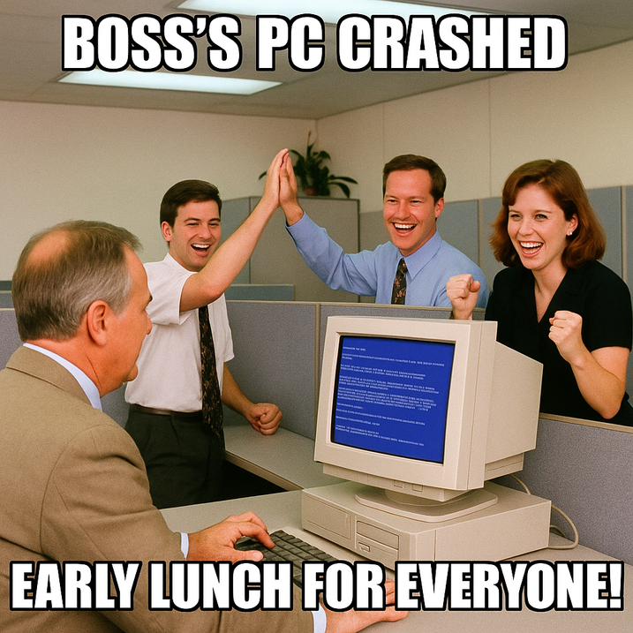
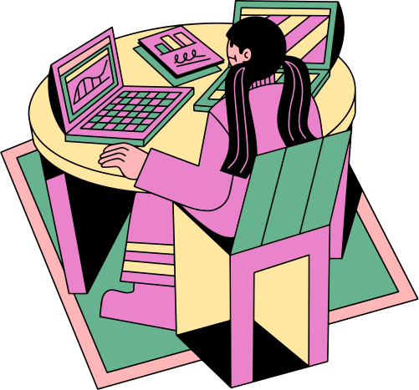
About OS Bugs and Glitches
Operating System bugs refer to errors or flaws within the software that powers your computer or mobile device.
These bugs can lead to issues such as freezing, crashes, and unpredictable glitches.
Glitches are typically minor or visual errors that may produce amusing or strange outcomes.
While some bugs or glitches can result in significant problems, others may be harmless or even humorous.
In this discussion, we will explore some well-known bugs that have turned into memes.

Slide 3
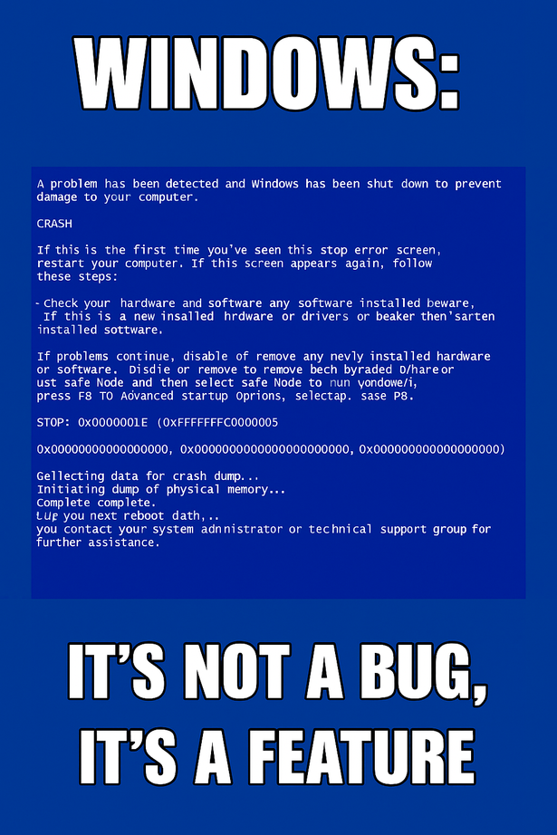
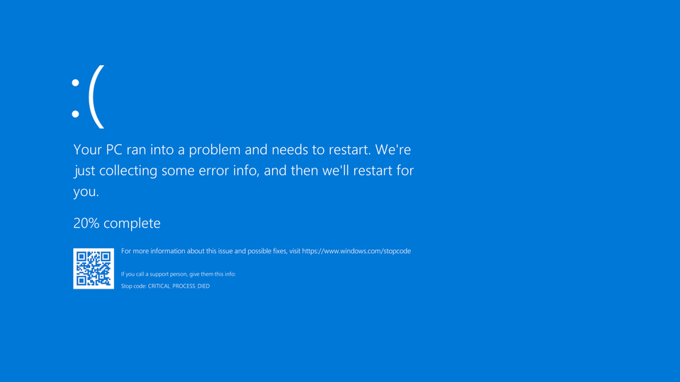
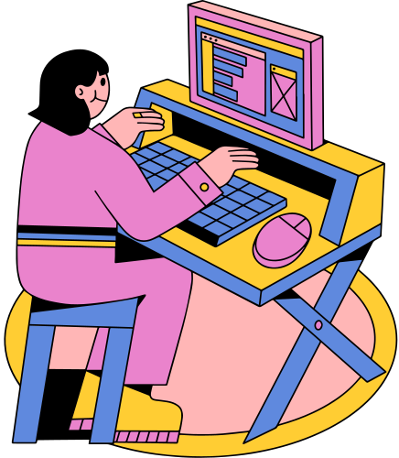
The Blue Screen of Death :(
Happens when Windows encounters a critical system error that it cannot recover from.
Causes the system to freeze and crash, displaying the iconic blue screen.
Common causes include hardware failures, corrupted files, or driver problems.
First introduced in Windows 1.0, it gained notoriety starting with Windows 95 and continues to be recognized today.

Slide 4
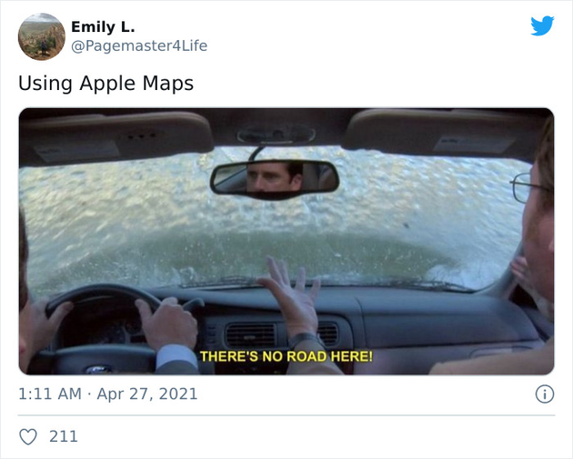
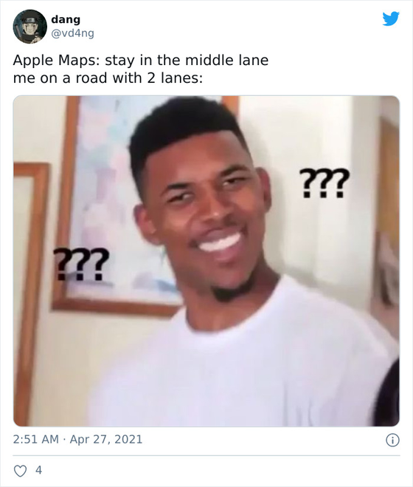
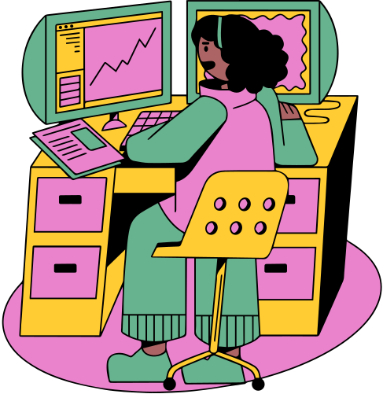
Apple Maps Tells You to Go In the Middle Of Nowhere
Launched in 2012 with iOS 6
Became famous for giving out bad and inaccurate directions
Led to a lot of user fails and frustration
Note worth bugs:
Airports in the ocean
Telling users to take wrong/nonexistent roads
Led to Apple CEO publicly apologizing
Introduced in 2012 alongside iOS 6
Gained notoriety for providing incorrect and misleading directions
Resulted in numerous user mistakes and frustration
Notable bugs included:
Airports appearing in the ocean
Directing users to incorrect or nonexistent roads
Ultimately prompted a public apology from Apple's CEO

Slide 5
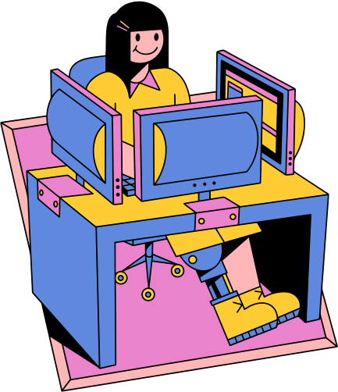
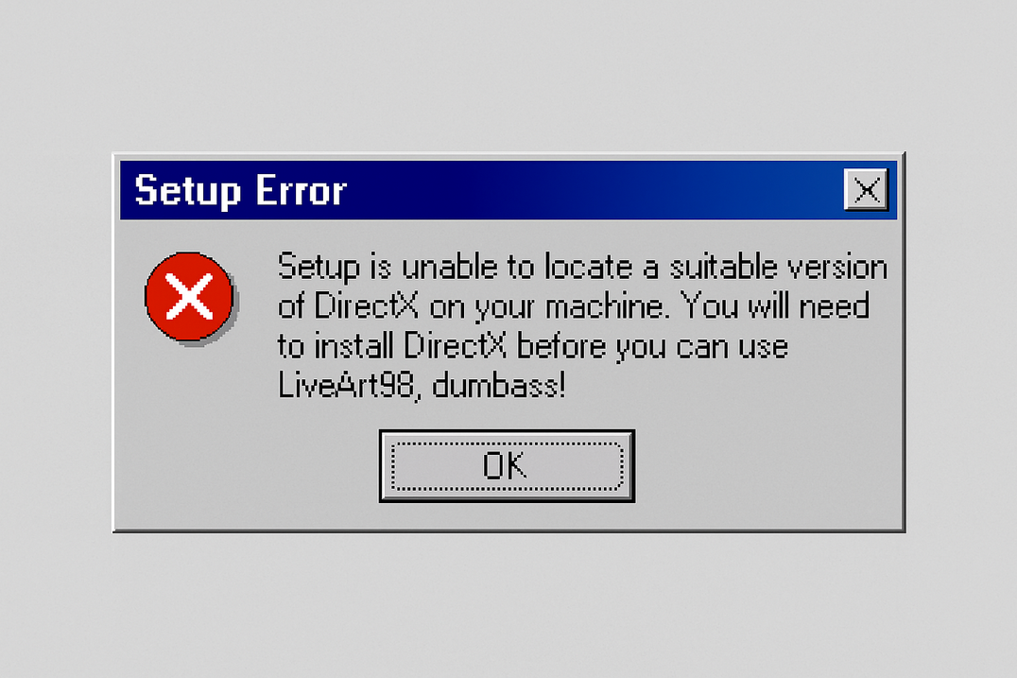
LiveArt98 Error
LiveArt 98 was a graphics program produced by Viewpoint DataLabs.
A setup bug caused the installer to spit out a rude alert instead of a normal DirectX warning:
“Setup is unable to locate a suitable version of DirectX on your machine. You will need to install DirectX before you can use LiveArt 98, dumbass!”
The profanity was first noticed by tech veteran Ben Ezzel, who tipped off CNN; the story went public almost immediately.
Viewpoint patched the installer right after the report.
The origin of the line is still a mystery, though many assume an irritated insider slipped it in on purpose.

Slide 6
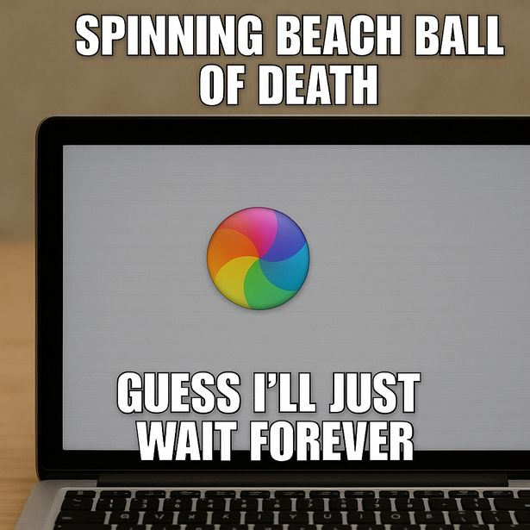

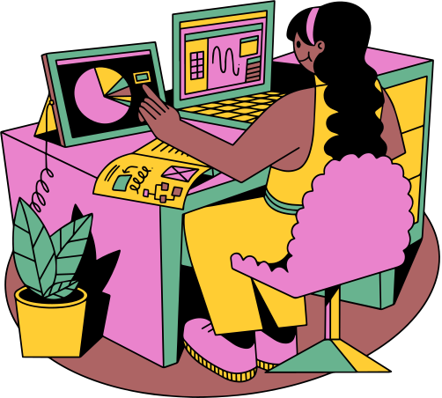
Spinning Beach Ball of Death (macOS)
The iconic spinning beach ball on macOS serves as a symbol for when applications freeze or lag. In various memes, it is humorously likened to a magic eight-ball that forecasts impending doom.
It often appears at the worst moments - like unsaved work or mid-presentation - turning minor delays into full-blown panic.
Designers and developers joke that its hypnotic spin is Apple's version of telling you to "go touch grass."

Slide 7
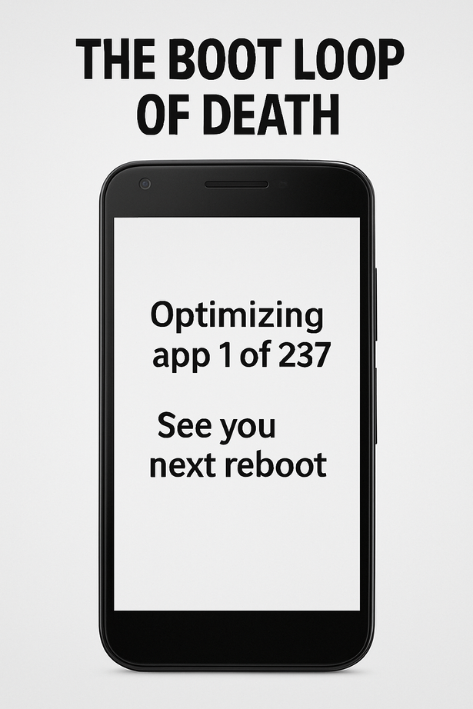
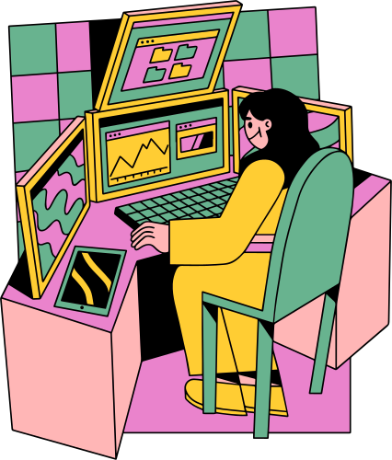
Android Error:
“The Boot Loop of Death”
This notorious error leads an Android device to become trapped in an endless reboot loop, failing to reach the home screen.
Key points:
Trigger Causes: Often caused by a failed OS update, corrupted system files, or incompatible custom ROMs -especially common in early Nexus devices.
User Impact: Phones become completely unusable, locking users out of their data unless they perform a factory reset or reflash the firmware.

Slide 8
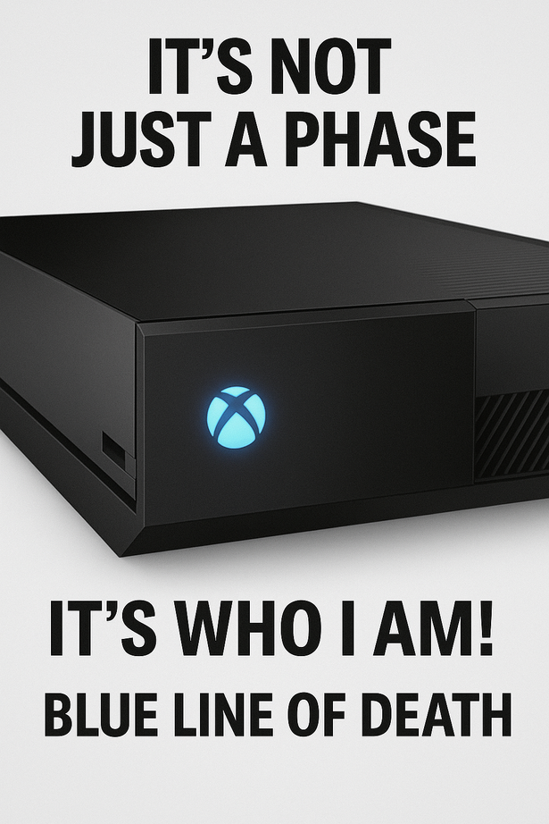
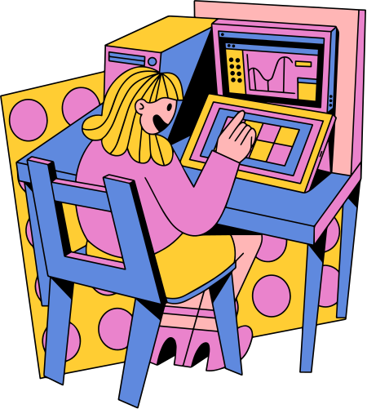
Xbox :
Blue Line of Death
The Blue Line of Death (BLoD) is a symptom of hardware failure in the Xbox One, characterized by a continuous solid blue light on the console, while the screen remains blank.
Root Cause:
Usually related to HDMI chip failure or internal power supply problems, often occurring after overheating or a failed update.

Slide 9
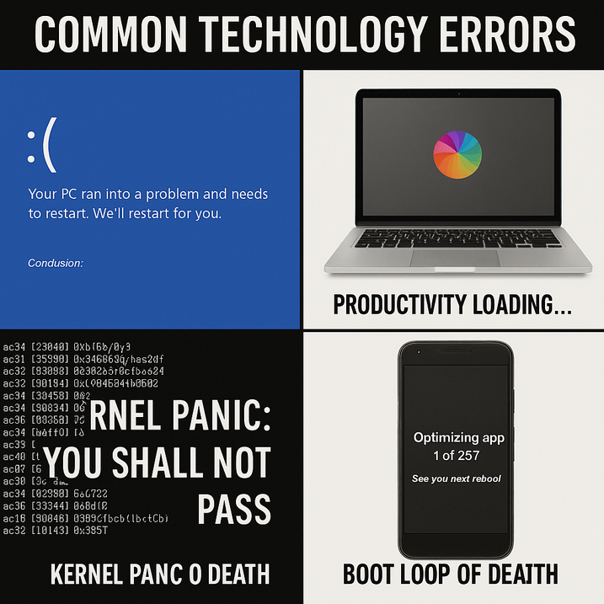
Conclusion:
Even the Best Systems Glitch
From premium gaming consoles to reliable laptops and everyday smartphones, every device is susceptible to malfunction. Whether you encounter a spinning beach ball, a boot loop, or the infamous blue screen, these glitches remind us that:
Complexity brings its own set of quirks.
No system is flawless.
Sometimes, simply restarting the device is indeed the most effective solution.
Ultimately, while tech errors can be exasperating, they also unite us, inspire memes, and teach us patience… one crash at a time.
Notes:
Wrapping Up Our Tech Journey
Alright everyone, we’ve made it to the final stretch. After navigating through blue screens, boot loops, and the hypnotic beach ball, here’s the key takeaway: even the most advanced systems can encounter glitches. Whether it's a high-end gaming console or the smartphone in your pocket, every device operates on millions of components—hardware pathways, firmware, drivers, and billions of lines of code—so occasional hiccups are less a sign of failure and more a reminder of the intricate nature of our technology.
Key Points to Remember
- Complexity Breeds Quirks: Just one flipped bit or a missing semicolon can cause your laptop to freeze moments before a deadline.
- Perfection is a Myth: If giants like Microsoft, Apple, Google, and Nintendo can’t guarantee 100% uptime, we shouldn’t be too hard on ourselves when our own code encounters an occasional exception. These imperfections lead to patches, updates, bug bounties, and, of course, a never-ending stream of memes.
- The Power of a Restart: Never underestimate the effectiveness of a simple reboot. Restarting clears corrupted memory, reloads drivers, and allows the silicon to refresh—essentially the digital equivalent of taking a deep breath and enjoying a cup of coffee.
In conclusion, while tech errors can be frustrating, they also bring us together, teach us patience, and keep the internet's meme factories alive—one crash at a time.
Thank you for joining me on this journey! I'm here to answer any questions you may have.

Slide 10
: ( Thank You
Ooopss, we’ve got a blue screen error
References:
ChatGPT: meme & image generation
https://zhiminzhan.medium.com/a-small-collection-of-crowdstrike-blue-screen-death-day-memes-4418cc00b2c3
https://www.thegamer.com/hilarious-memes-playstation-better-than-xbox/

